Slide 1

Pilares para a criação de um código, uma visão sobre padrões de projeto e qualidade.

Slide 2
Pillars for creating code, insight into design standards and quality.

Slide 3
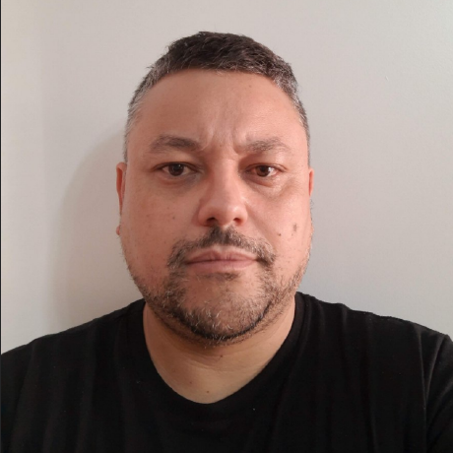








Weder Mariano de Sousa
GOJava
Analist System Senior - GFT Brazil
+ 16 Years of Experience
+ 50 Projects Worked
Post Graduate in Media UFG
Post Graduate in Information Security
Computer scientist
IT Technician ITGO
AWS User Group Goiânia
Grupy-GO
https://www.linkedin.com/in/wedermarianodesousa/
https://github.com/weder96

Slide 4
Software Development Life Cycle
Design Patterns
Software Architecture
Clean Architecture
Agenda
Monolithic
Microservices
Serverless
Clean Code
Pillars for Creating Code

Slide 5
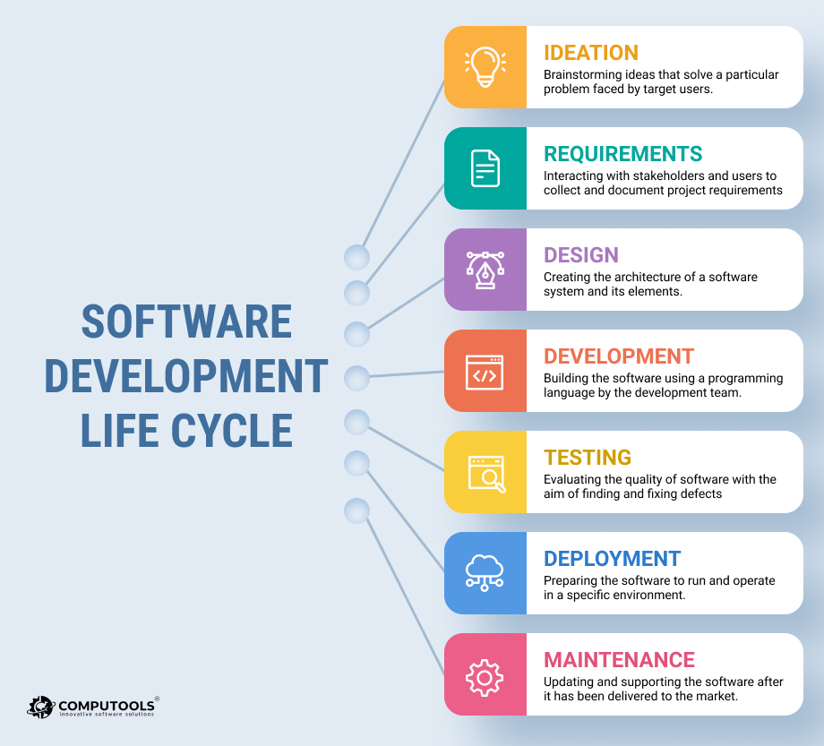
Software Development Life Cycle

Slide 6
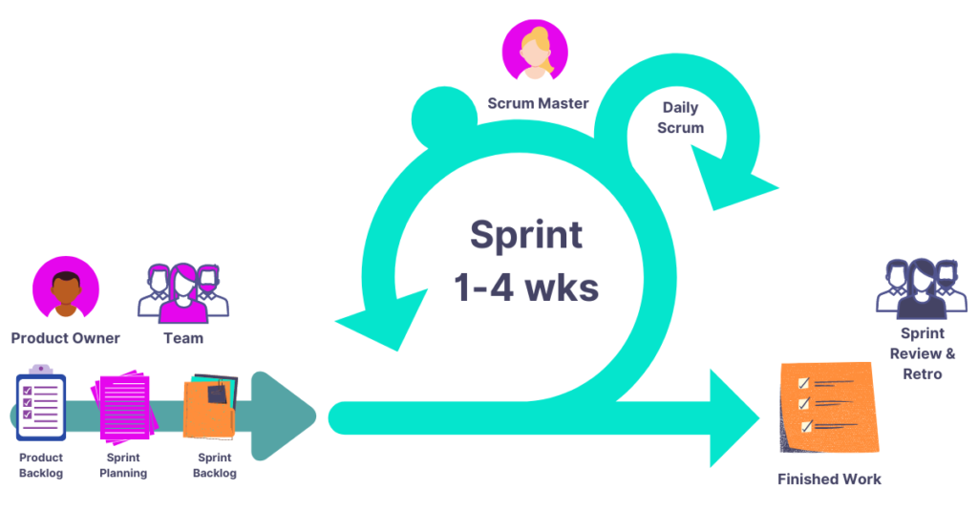
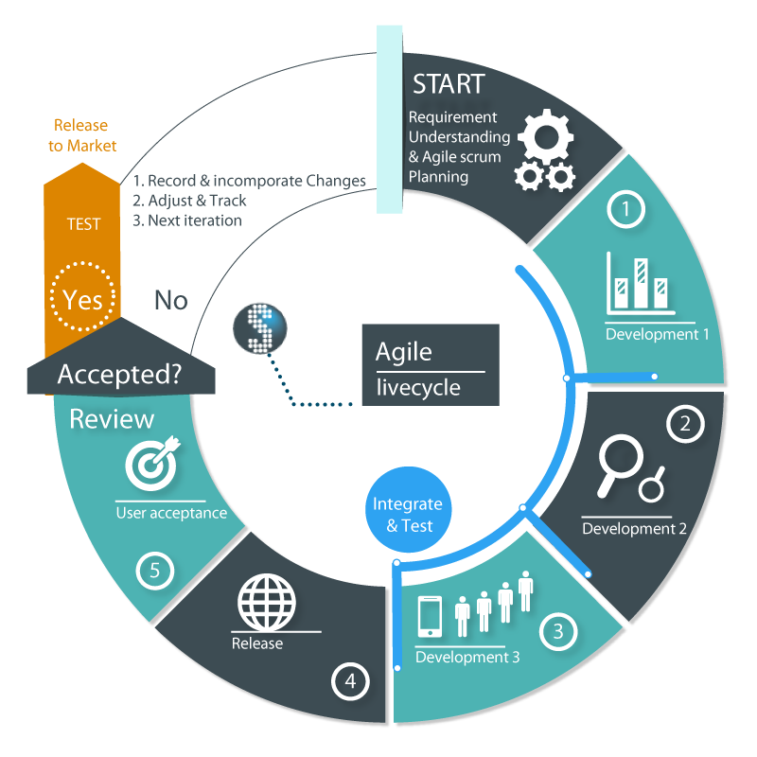
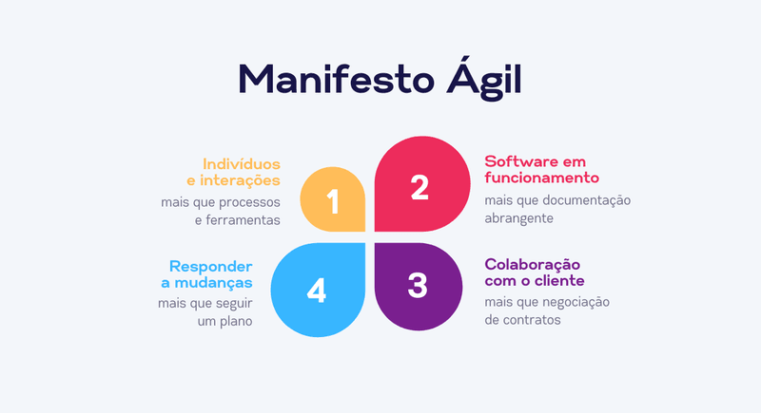
Agile Software Development Methodology
https://www.scrum.org/
https://blog.geekhunter.com.br/manifesto-agil/

Slide 7

DESIGN PATTERNS

Slide 8
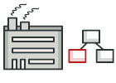
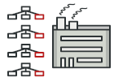
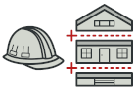
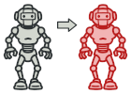
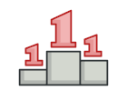
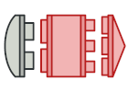

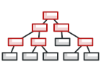
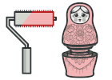

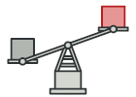
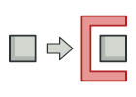
Design Patterns Catalog
Creational Patterns (5)
These patterns provide various object
creation mechanisms, which increase
flexibility and reuse of existing code.
Factory
Method
Abstract
Factory
Bulder
Prototype
Singleton
Structural Patterns (7)
These patterns explain how to
assemble objects and classes into
larger structures while keeping these
structures flexible and efficient.
Adapter
Bridge
Composite
Decorator
Facade
Flyweight
Proxy
https://refactoring.guru/design-patterns/catalog
https://github.com/weder96/javaaula21/tree/main/ProjectDesignPartners/src/main/java/Pack20DesignPatterns

Slide 9
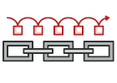
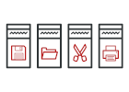
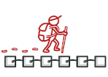
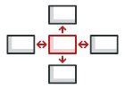
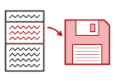

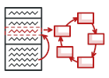
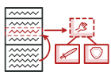
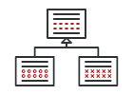
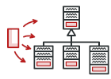
Design Patterns Catalog
Behavioral Patterns (10)
These patterns are concerned
with algorithms and the assignment
of responsibilities between objects.
Chain of
Responsability
Command
Iterator
Mediator
Memento
Observer
State
Strategy
Template
Method
Visitor
https://refactoring.guru/design-patterns/catalog
https://github.com/weder96/javaaula21/tree/main/ProjectDesignPartners/src/main/java/Pack20DesignPatterns

Slide 10

Design Patterns Catalog
Architectural Standards
Data Access
Object
Flux
Lazy
Loading
Model View
Controller
Model View
Presenter
Model View
View Model
https://github.com/weder96/javaaula21/tree/main/ProjectDesignPartners/src/main/java/Pack20DesignPatterns

Slide 11
Design Patterns Catalog
Other Design Patterns
Acyclicvisitor
Data Mapper
EventQueue
mutex
Service Layer
Ambassador
Databus
Execute Around
nullobject
Specification
Balking
Locality
Data Transfer
object Pool
Thread Pool
Bytecode
Delegate
Properrty
pipeline
Tolerant Reader
Callback
Circuit Breaker
Dependency Injection
Private Class Data
Resource
Acquisition
IsInitialization
Twin
Collection Pipeline
Double Dispatch
monostate
Combinator
Event Aggregator
multiton
Servant
https://github.com/weder96/javaaula21/tree/main/ProjectDesignPartners/src/main/java/Pack20DesignPatterns

Slide 12
Software Architecture

Slide 13
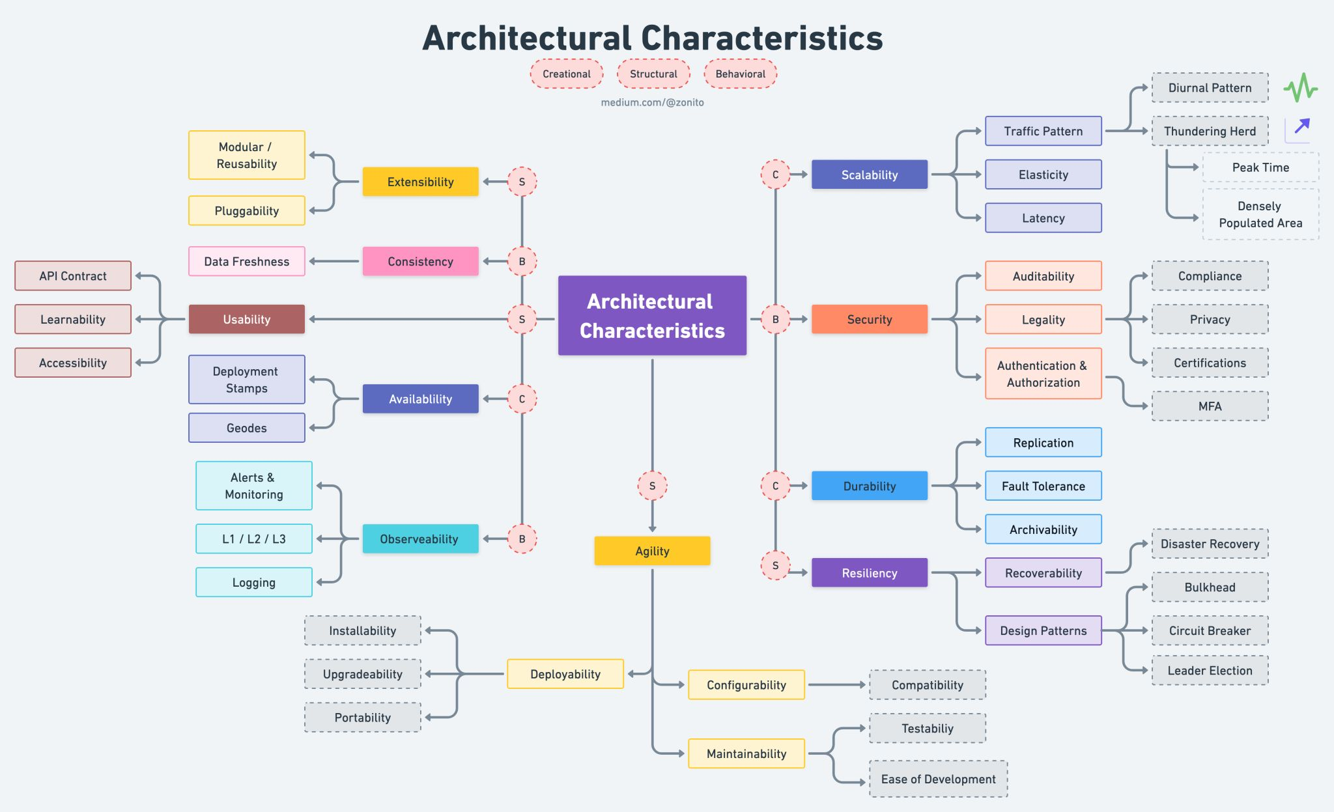
Software Architecture
1. Scalability
2. Availability
3. Extensibility
4. Consistency
5. Resiliency
6. Usability
7. Observability
8. Security
9. Durability
10. Agility
https://blog.devgenius.io/top-10-architecture-characteristics-non-functional-requirements-with-cheatsheat-7ad14bbb0a9b

Slide 14
Clean Architecture

Slide 15

Clean Architecture
The goal of software architecture is to minimize the human resources required to build and
maintain the required system.
SOLID
Hexagonal
https://www.zup.com.br/blog/clean-architecture-arquitetura-limpa

Slide 16
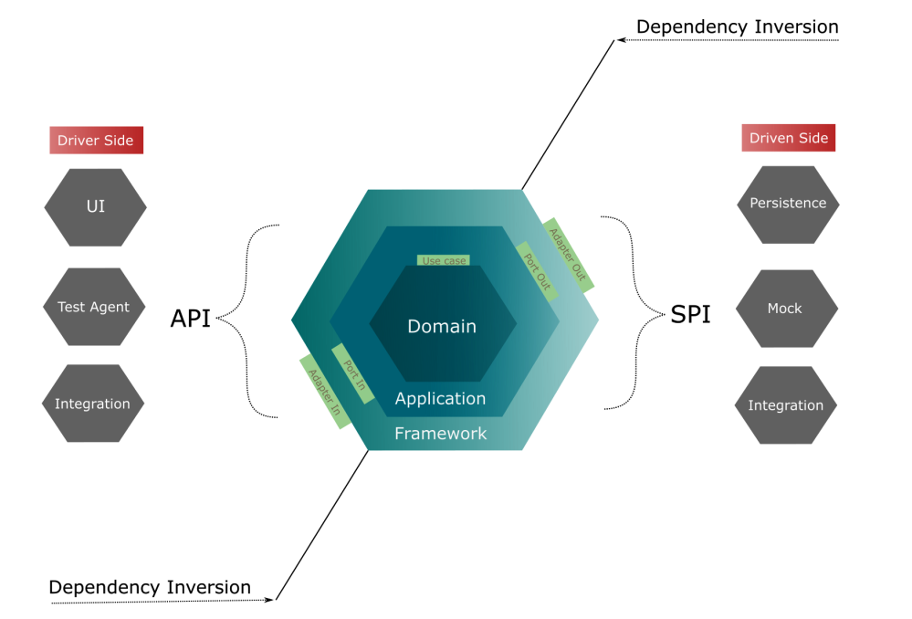
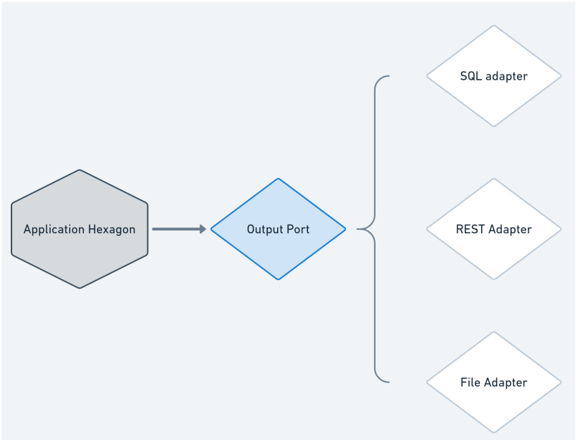
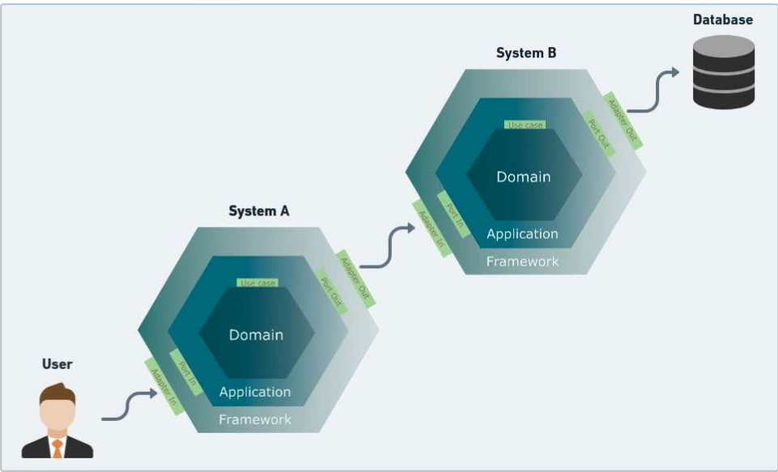
Understanding the Hexagonal Architecture
https://www.zup.com.br/blog/clean-architecture-arquitetura-limpa

Slide 17
Monolithic
Microservices
Serverless

Slide 18
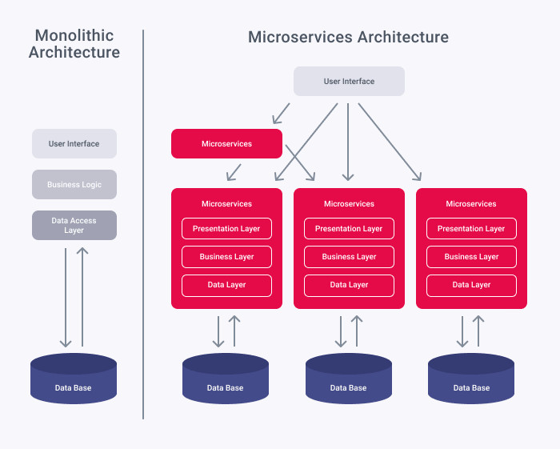
Monolithic vs Microservices
https://xbsoftware.com/blog/microservices-vs-monolithic-architecture/
https://arquiteturadesoftware.online/integrando-sistemas-de-software/

Slide 19
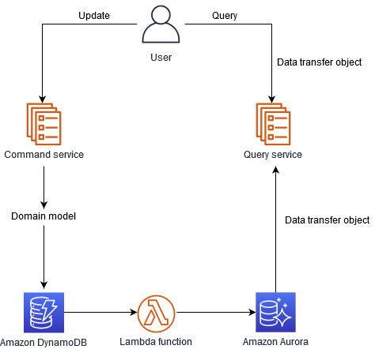
Microservices Management Database
Database per Service
Shared database
Saga
API Composition (API Gateway)
CQRS (Command Query Responsibility Segregation)
Domain event
Event sourcing
https://microservices.io/
https://docs.aws.amazon.com/prescriptive-guidance/latest/modernization-data-persistence/cqrs-pattern.html
https://github.com/weder96/microServiceDemo

Slide 20
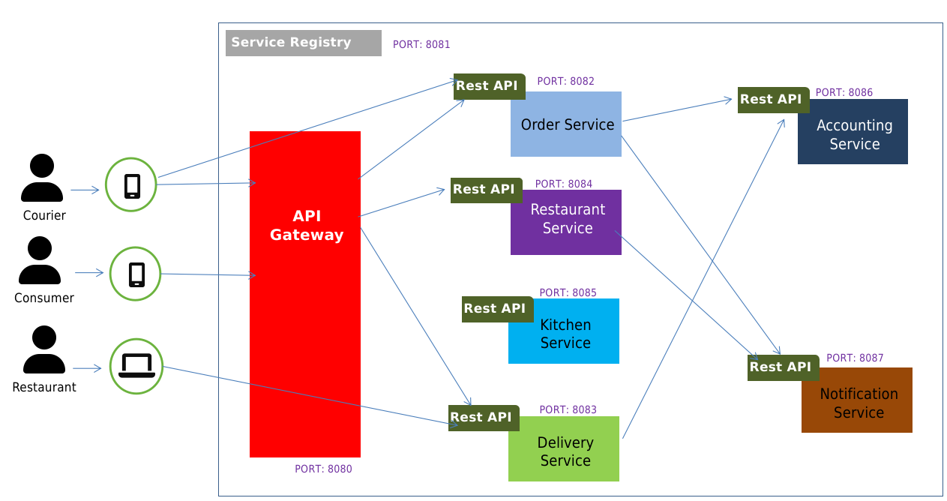
Microservices - Service Discovery
Client-side discovery
Server-side discovery
Service registry
Self registration
3rd party registration
https://microservices.io/
https://github.com/weder96/microServiceDemo
https://github.com/weder96/microServiceDemo/blob/main/documents/microservices-patterns-spring-projects-eureka-server-class-test.pdf

Slide 21
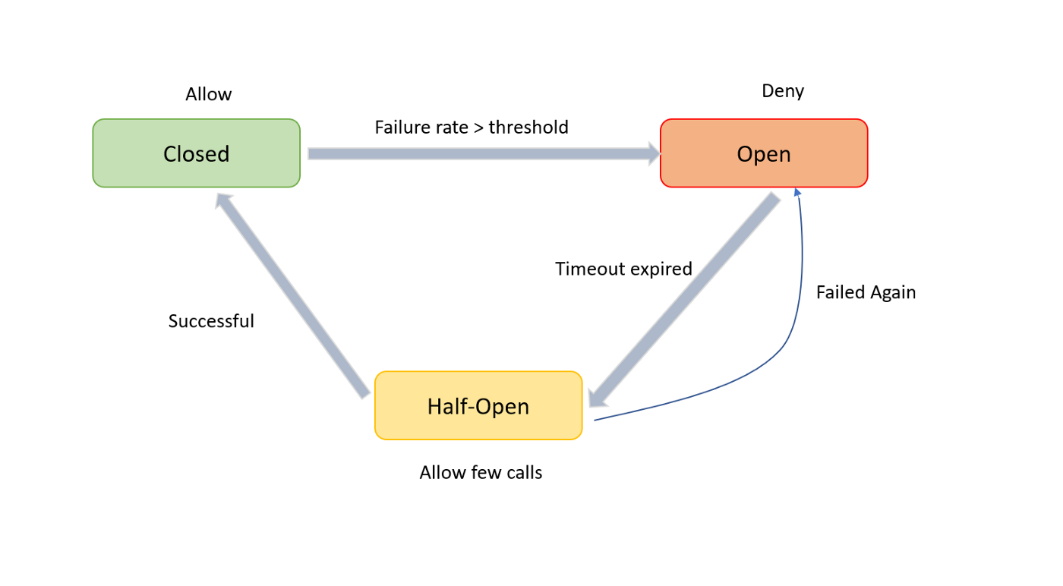
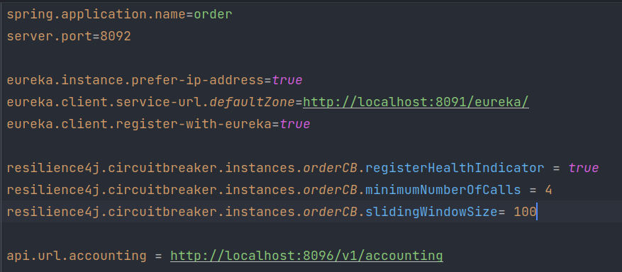
Microservices - Reliability
Circuit Breaker
https://microservices.io/
https://github.com/weder96/microServiceDemo/blob/main/order/src/main/java/com/wsousa/order/controller/OrderController.java

Slide 22
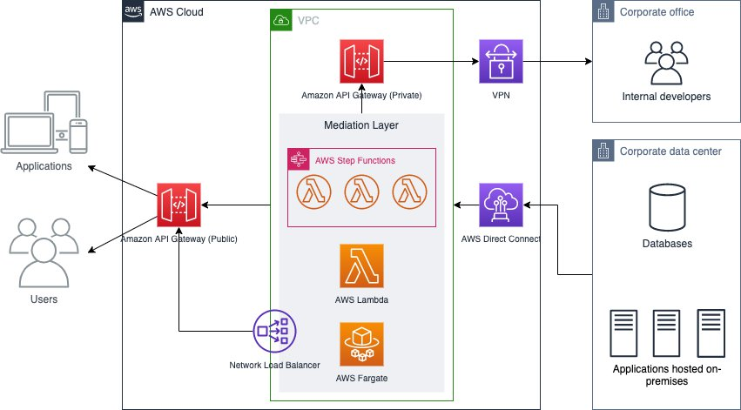
Serverless Architecture
https://aws.amazon.com/pt/blogs/architecture/unlocking-data-from-existing-systems-with-serverless-api-facade/

Slide 23
Clean Code

Slide 24
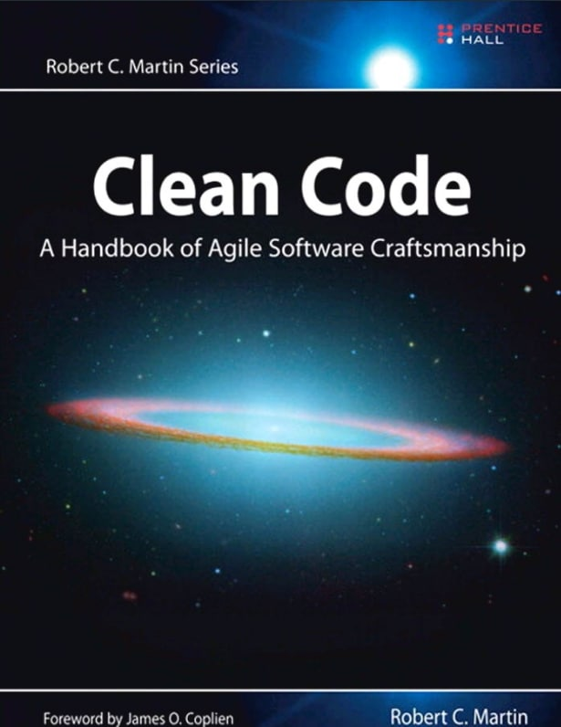
Clean Code
Why are we talking so much about clean code (Clean Code)
and why is this so important to us? In fact the maintenance
of a software is as important as its construction.
As reported by Robert C. Martin in his classic book, Clean Code,
a Best Seller in our area, some practices and visions are very important
to maintain the life of our software.
Companies invest millions in software every year, but with so many
changes in the team and technologies, how to make this investment last?
How to guarantee a good maintenance, durability, life to the software? .
https://balta.io/artigos/clean-code
https://www.sydle.com/br/blog/clean-code-602bef23da4d09680935509b/

Slide 25
S.O.L.I.D - The 5 Principles of OOP
SRP — Single Responsiblity Principle (Princípio da responsabilidade única)
OCP — Open-Closed Principle (Princípio Aberto-Fechado)
LSP — Liskov Substitution Principle (Princípio da substituição de Liskov)
ISP — Interface Segregation Principle (Princípio da Segregação da Interface)
DIP — Dependency Inversion Principle (Princípio da inversão da dependência)

Slide 26
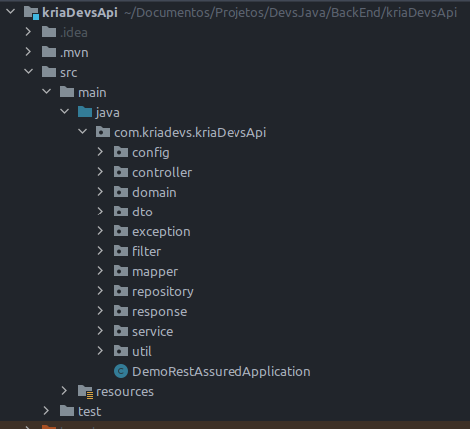
SRP — Single Responsiblity Principle
SRP: The Single Responsibility Principle
A module should have one, and only one, reason to change.
A module should be responsible to one, and only one,
user or stakeholder.
A module should be responsible to one, and only one, actor.
The Single Responsibility Principle (part of SOLID, by Robert C. Martin 2000)

Slide 27
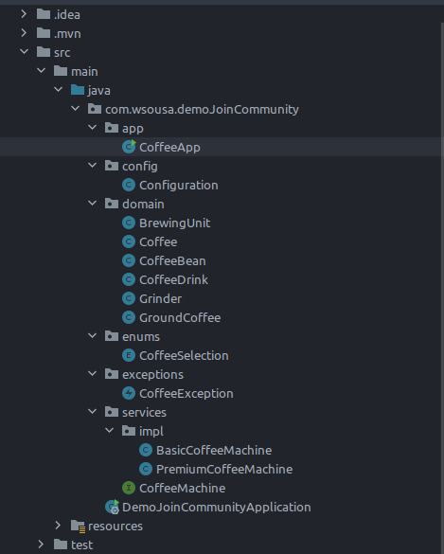
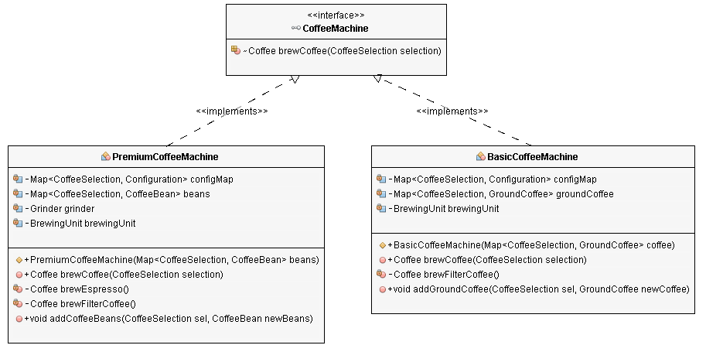
OCP — Open-Closed Principle
“Software entities (classes, modules, functions, etc.) should be open for extension,
but closed for modification.”
“A class is closed, since it may be compiled, stored in a library, baselined, and used by client classes. But it is also open, since any new class may use it as parent, adding new features. When a descendant class is defined, there is no need to change the original or to disturb its clients.”
https://stackify.com/solid-design-open-closed-principle/

Slide 28
LSP — Liskov Substitution Principle
“Let Φ(x) be a property provable about objects x of type T. Then Φ(y) should be true for objects y of type S where S is a subtype of T.”
The Liskov Substitution Principle is the third of Robert C. Martin’s SOLID design principles.
It extends the Open/Closed principle and enables you to replace objects of a parent class
with objects of a subclass without breaking the application. This requires all subclasses to behave
in the same way as the parent class. To achieve that, your subclasses need to follow these rules:
Don’t implement any stricter validation rules on input
parameters than implemented by the parent class.
Apply at the least the same rules to all output parameters
as applied by the parent class.
https://stackify.com/solid-design-liskov-substitution-principle/

Slide 29
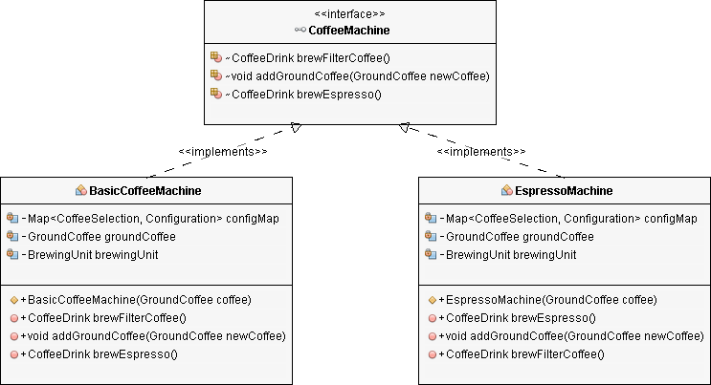
ISP — Interface Segregation Principle
“Clients should not be forced to depend upon interfaces that they do not use.”
Similar to the Single Responsibility Principle, the goal of the
Interface Segregation Principle is to reduce the side effects
and frequency of required changes by splitting the software
into multiple, independent parts.
https://stackify.com/interface-segregation-principle/

Slide 30
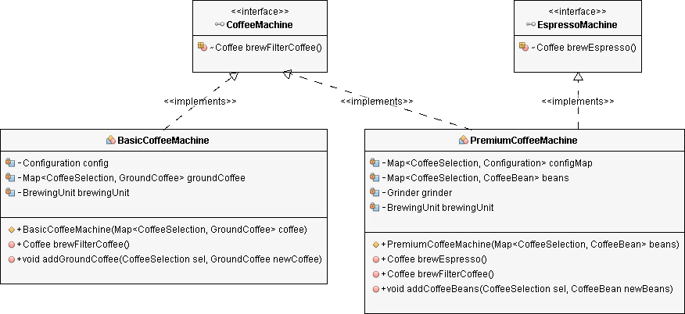
DIP — Dependency Inversion Principle
Dependency Inversion Principle consists of two parts:
1. High-level modules should not depend
on low-level modules. Both should depend
on abstractions.
2. Abstractions should not depend on details.
Details should depend on abstractions.
This might sound more complex than it often is. If you consequently apply the Open/Closed Principle and the Liskov Substitution
Principle to your code, it will also follow the Dependency Inversion Principle.
https://stackify.com/dependency-inversion-principle/

Slide 31
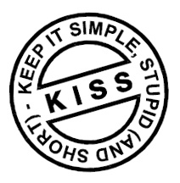
KISS - Keep It Simple, but Sensational
The KISS principle states that most systems work best if they are kept simple rather than complicated.
Therefore, simplicity must be a fundamental objective in the design and unnecessary complexity must
be avoided.
The KISS Principle (Keep It Simple) is self-descriptive and recognizes two things:
1. People – the users of products and services – often want simple things, which are easy to learn and use;
2. The company that manufactures products or provides services also has a lot to bring to the concept of
“keep it simple”, as it tends to reduce time and reduce internal cost.
https://harve.com.br/blog/marketing-digital-blog/keep-it-simple-but-sensational-o-principio-kiss-para-impactar/

Slide 32
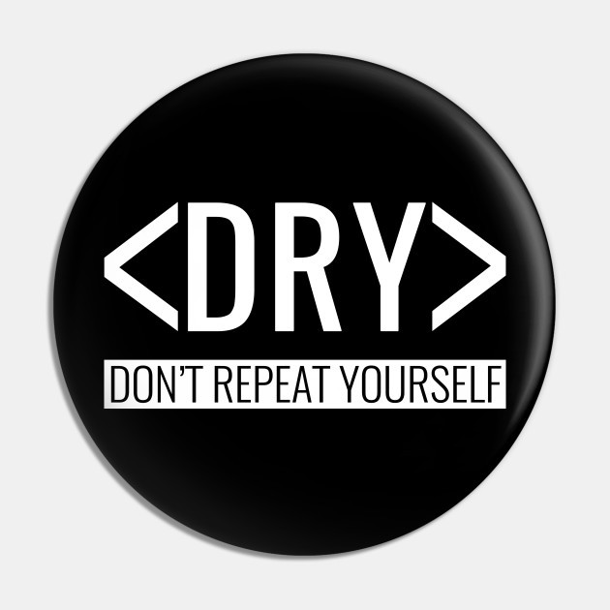
The "Don't Repeat Yourself" Principle (DRY)
The DRY principle, an acronym for Don’t Repeat Yourself,
created by Andy Hunt, proposes that every feature in a project should be represented
only once.
Who, at some point in their life, has never witnessed others or themselves changing various classes,
pages, or files, while maintaining some system, just to fix a single detail?
This is the chasm that repetition, without proper refactoring or planning, gives us.
Without attention and care for the code, entropy kicks in and chaos sets in easily and quickly,
often silently, until it trumpets at a later time during a bug, rollout of new features, or any other maintenance.
https://www.profissionaisti.com.br/o-principio-do-nao-se-repita-dry/

Slide 33
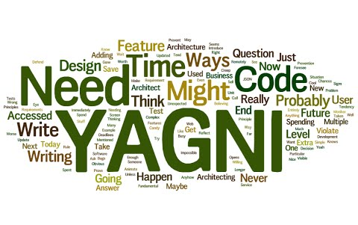
YAGNI - You Aren't Gonna Need It
This is a principle of the agile methodology XP (Extreme Programming) that suggests that you should
not add things that you will not use in your code.
On a day-to-day basis, I see this very related to Over Engineering, that is, creating a much more
complex solution than necessary.
Thinking about a future situation that may never exist.
https://dev.to/thiagomr/desvendando-o-mundo-magico-dos-acronimos-solid-kiss-yagni-dry-ddd-tdd-2onp

Slide 34
Why use Code Conventions
80% of the time programmers should be focused on business rules,
understanding, studies and another 20% programming, and there would still be time to improve the code;
Hardly a code will be kept "forever" by its original creator;
Well-written, well-descriptive, well-annotated code increases productivity, decreases the amount
of training, facilitates reading and is visually pleasing;
If you sell your code as a product, you must make sure it is a well-tested product,
packaged to be delivered and that does what it promises, delivering value to its customer;
Conventions standardize usability methods with good practices based on knowledge and
experience of a body specialized in the area;
https://www.sonarlint.org/

Slide 35
Pillars for creating code, insight into design standards and quality

Slide 36

Pilares para Codificação
1. A prioridade máxima é funcionar de acordo com o caso de uso. Beleza e formosura são somente detalhes.
2. Execute o seu código o mais rápido possível. Estou falando de execução real, não de testes automatizados.
3. Protegemos as bordas do sistema como se não houvesse amanhã.
4. Quanto mais externa a borda, mais proteção temos.
5. Não retornamos nulo dentro das regras da aplicação. Pense que seu computador vai explodir.
6. Separamos as bordas externas do sistema do seu núcleo. Não ligamos parâmetros de requisição externa
com objetos de domínio diretamente, assim como não serializamos objetos de domínio para respostas de API.
https://github.com/asouza/pilares-design-codigo

Slide 37

Pillars for Coding
1. Top priority is to work according to the use case. Beauty and beauty are just details.
2. Run your code as quickly as possible. I'm talking about actual execution, not automated tests.
3. We protect the edges of the system like there's no tomorrow.
4. The further the edge, the more protection we have.
5. We do not return null within the application rules. Think your computer is going to explode.
6. We separate the outer edges of the system from its core. We don't bind external request parameters
with domain objects directly, just as we don't serialize domain objects to API responses.
https://github.com/asouza/pilares-design-codigo

Slide 38
Pilares para Codificação
7. Avaliamos de forma lógica o nível de complicação de cada trecho de código.
Aqui não tem espaço para feeling.
Usamos a teoria da carga cognitiva e medimos o nível de pontos de entendimentos necessário por trecho.
8. Toda indireção aumenta a dificuldade de entendimento da aplicação como um todo,
ela precisa merecer existir. ou seja, precisa ajudar a distribuir a carga intrínseca pelo sistema.
9. Usamos o construtor para criar o objeto no estado válido.
https://github.com/asouza/pilares-design-codigo

Slide 39
Pillars for Coding
7. We logically assess the level of complication of each piece of code.
There's no space for feeling.
We use cognitive load theory and measure the level of understanding points needed per stretch.
8. Any indirection increases the difficulty of understanding the application as a whole, it must deserve to exist.
that is, it needs to help distribute the intrinsic load across the system.
9. We use the constructor to create the object in the valid state.
https://github.com/asouza/pilares-design-codigo

Slide 40
Pilares para Codificação
10. A complicação do nosso é código é proporcional a complicação da nossa feature.
Quanto mais simples, melhor.
11. Usamos tudo que conhecemos que está pronto.
Só fazemos código do zero se for estritamente necessário.
12. Idealmente, todo código escrito deveria ser chamado por alguém.
Se não tem ninguém chamando, ele não deveria existir.
13. Só alteramos estado de referências que criamos. Não mexemos nos objetos alheios.
A não ser que esse objeto seja criado para isso, como é o caso de argumentos de métodos de borda
mais externa.
Estes são, geralmente, associados a frameworks.
https://github.com/asouza/pilares-design-codigo

Slide 41
Pillars for Coding
10. The complication of our code is proportional to the complication of our feature.
The simpler the better.
11. We use everything we know that is ready.
We only code from scratch if strictly necessary.
12. Ideally, all code written should be called by someone.
If there's no one calling, he won't should exist.
13. We only change the status of references we create. We don't touch other people's objects.
Unless this object be created for this, as is the case for outermost edge method arguments.
These are usually associated with frameworks.
https://github.com/asouza/pilares-design-codigo

Slide 42
Pilares para Codificação
14. A versão mais eficiente de uma pessoa programando é aquela que entende, questiona e implementa
estritamente o que foi combinado.
Não inventamos coisas que não foram pedidas,
Não fazemos suposição de funcionalidade e nem caímos na armadilha de achar que entendemos
mais do que a pessoa que solicitou a funcionalidade.
https://github.com/asouza/pilares-design-codigo

Slide 43
Pillars for Coding
14. The most efficient version of a programming person is one that understands, questions, and implements
strictly what was agreed.
We don't invent things that weren't asked for,
We don't make assumptions about functionality and we don't fall for the trap of thinking we understand
more than the person who requested the functionality.
https://github.com/asouza/pilares-design-codigo

Slide 44
Pilares para Codificação
15. Você precisa entender o que está usando e olhar sempre o lado negativo de cada decisão.
16. Deixamos pistas que facilitem o uso do código onde não conseguimos resolver com compilação.
17. A sua api deve deixar claro o caminho que deve ser seguido pelo ponto do código que decide usá-la.
Não espere que ninguém lembre de invocar nada. Faça de tudo para gerar obrigações. Quanto mais específico
é seu código, menos democrático ele é.
https://github.com/asouza/pilares-design-codigo

Slide 45
Pillars for Coding
15. You need to understand what you are using and always look at the negative side of every decision.
16. We leave clues that facilitate the use of the code where we can't solve with compilation.
17. Your api should make clear the path that should be followed by the code point that decides to use it.
Don't expect anyone to remember to summon anything. Do everything to generate obligations. the more specific
is its code, the less democratic it is.
https://github.com/asouza/pilares-design-codigo

Slide 46
Pilares para Codificação
18. Não usamos exception para controle de fluxo.
19. Regras de negócio devem ser declaradas de maneira explícita na nossa aplicação.
20. Favorecemos a coesão através do encapsulamento.
21. Criamos testes automatizados para que ele nos ajude a revelar e consertar bugs na aplicação.
https://github.com/asouza/pilares-design-codigo

Slide 47
Pillars for Coding
18. We don't use exception for flow control.
19. Business rules must be stated explicitly in our application.
20. We favor cohesion through encapsulation.
21. We create automated tests so that it helps us to reveal and fix bugs in the application.
https://github.com/asouza/pilares-design-codigo

Slide 48
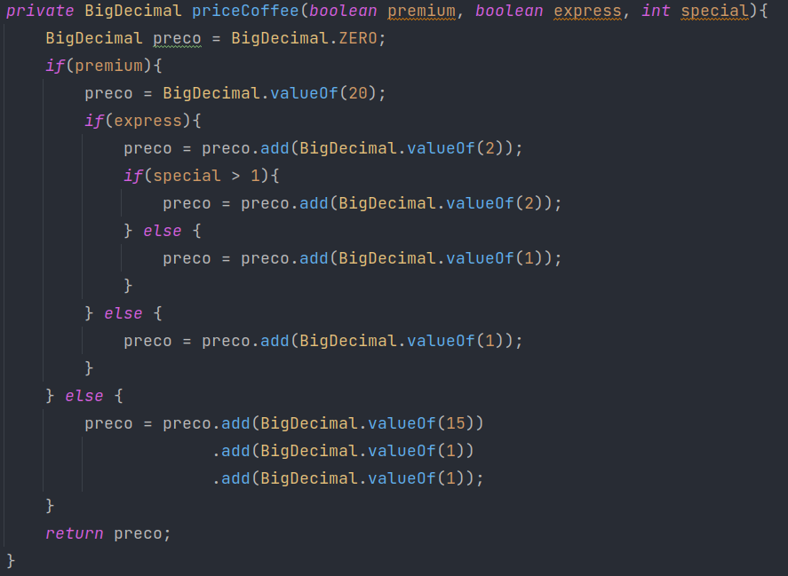
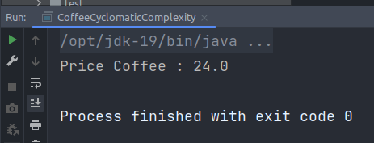
Cyclomatic Complexity
https://artesoftware.com.br/2019/02/09/complexidade-ciclomatica/

Slide 49
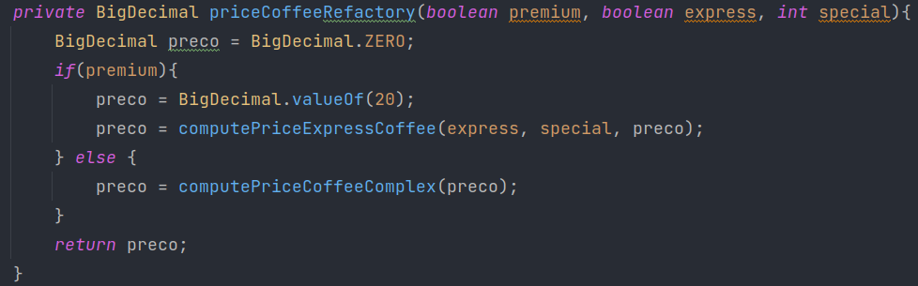
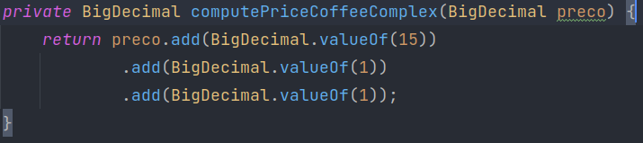
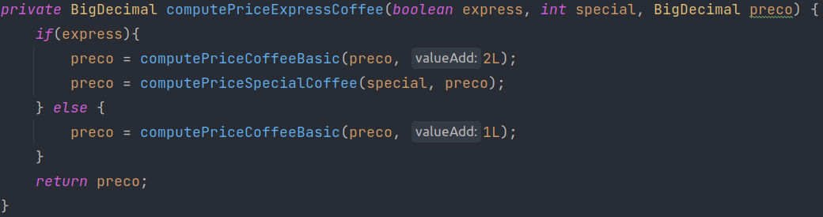
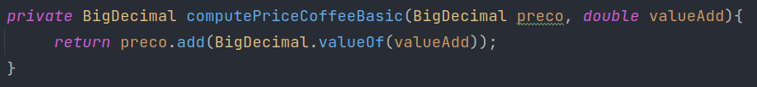
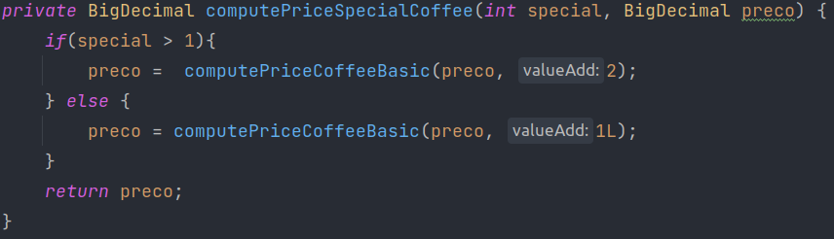
Cyclomatic Complexity - Refactory
https://artesoftware.com.br/2019/02/09/complexidade-ciclomatica/

Slide 50


Books that changed my mind
https://github.com/asouza/pilares-design-codigo

Slide 51
Weder Mariano de Sousa
GOJava
Analist System Senior - GFT Brazil
+ 16 Years of Experience
+ 50 Projects Worked
Post Graduate in Media UFG
Post Graduate in Information Security
Computer scientist
IT Technician ITGO
AWS User Group Goiânia
Grupy-GO
Q & A
https://www.linkedin.com/in/wedermarianodesousa/
https://github.com/weder96

Slide 52
THANK YOU

